Slide 1
THE LIFE OF CHRIST

Slide 2
Matthew 27:39 And those who passed by blasphemed Him, wagging their heads ⁴⁰ and saying, "You who destroy the temple and build it in three days, save Yourself! If You are the Son of God, come down from the cross." ⁴¹ Likewise the chief priests also, mocking with the scribes and elders, said, ⁴² "He saved others; Himself He cannot save. If He is the King of Israel, let Him now come down from the cross, and we will believe Him. ⁴³ "He trusted in God; let Him deliver Him now if He will have Him; for He said,`I am the Son of God.'" ⁴⁴ Even the robbers who were crucified with Him reviled Him with the same thing.

Slide 3
Mark 15:29 And those who passed by blasphemed Him, wagging their heads and saying, "Aha! You who destroy the temple and build it in three days, ³⁰ "save Yourself, and come down from the cross!" ³¹ Likewise the chief priests also, mocking among themselves with the scribes, said, "He saved others; Himself He cannot save. ³² "Let the Christ, the King of Israel, descend now from the cross, that we may see and believe." Even those who were crucified with Him reviled Him.

Slide 4
Luke 3:36 The soldiers also mocked Him, coming and offering Him sour wine, ³⁷ and saying, "If You are the King of the Jews, save Yourself." ³⁸ And an inscription also was written over Him in letters of Greek, Latin, and Hebrew¹: THIS IS THE KING OF THE JEWS.

Slide 5
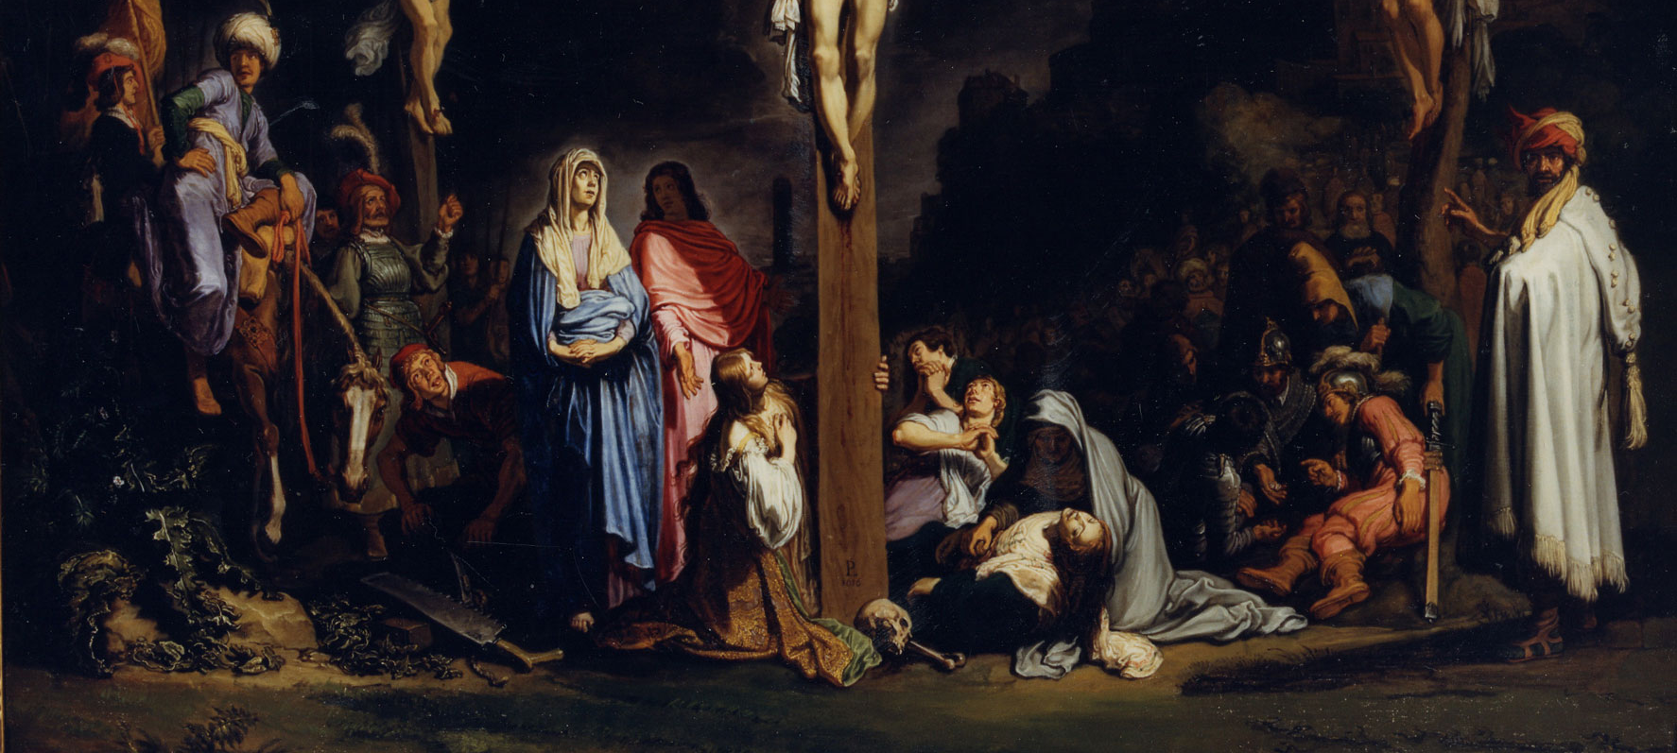

Slide 6
Luke 23:39 Then one of the criminals who were hanged blasphemed Him, saying, "If You are the Christ, save Yourself and us." 40 But the other, answering, rebuked him, saying, "Do you not even fear God, seeing you are under the same condemnation? 41 "And we indeed justly, for we receive the due reward of our deeds; but this Man has done nothing wrong." 42 Then he said to Jesus, "Lord, remember me when You come into Your kingdom." 43 And Jesus said to him, "Assuredly, I say to you, today you will be with Me in Paradise."

Slide 7
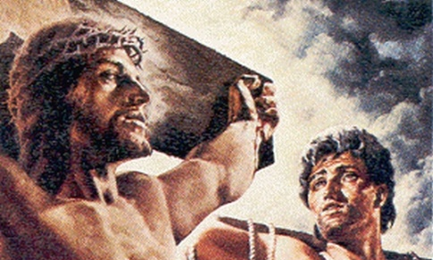

Slide 8
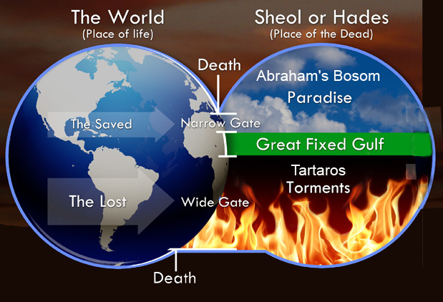

Slide 9
Acts 2:30 "Therefore, being a prophet, and knowing that God had sworn with an oath to him that of the fruit of his body, according to the flesh, He would raise up the Christ to sit on his throne, ³¹ "he, foreseeing this, spoke concerning the resurrection of the Christ, that His soul was not left in Hades, nor did His flesh see corruption.

Slide 10
Everything we know about these two thieves is recorded in the four Gospels (Mat. 27:38, 44; Mk. 15:27-28, 32; Lk. 23:32-33, 39-43; Jn. 19:18, 32).
“Then Jerusalem, all Judea, and all the region around the Jordan went out to him and were baptized by him in the Jordan, confessing their sins (Mat 3:5-6).”

Slide 11
Those under the Law of Moses had to offer up animal sacrifices and give tithes, but Christians are not required to do this because we are under the Law of Christ (Gal. 6:2; 1 Cor. 9:21).

Slide 12
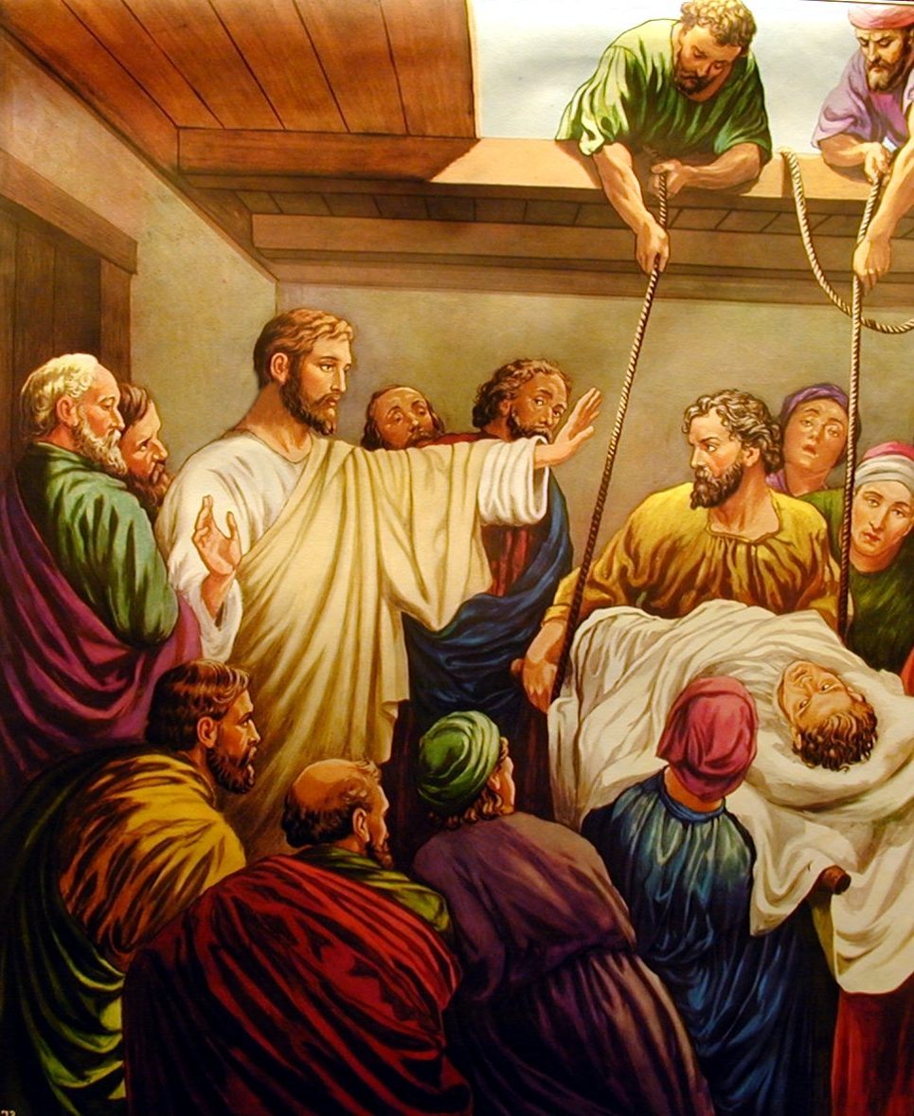
“When Jesus saw their faith, He said to the paralytic, "Son, your sins are forgiven you (Mk. 2:5)."

Slide 13
"Which is easier, to say to the paralytic, 'Your sins are forgiven you,' or to say, 'Arise, take up your bed and walk'? "But that you may know that the Son of Man has power on earth to forgive sins (Mk. 2:9-10)."

Slide 14
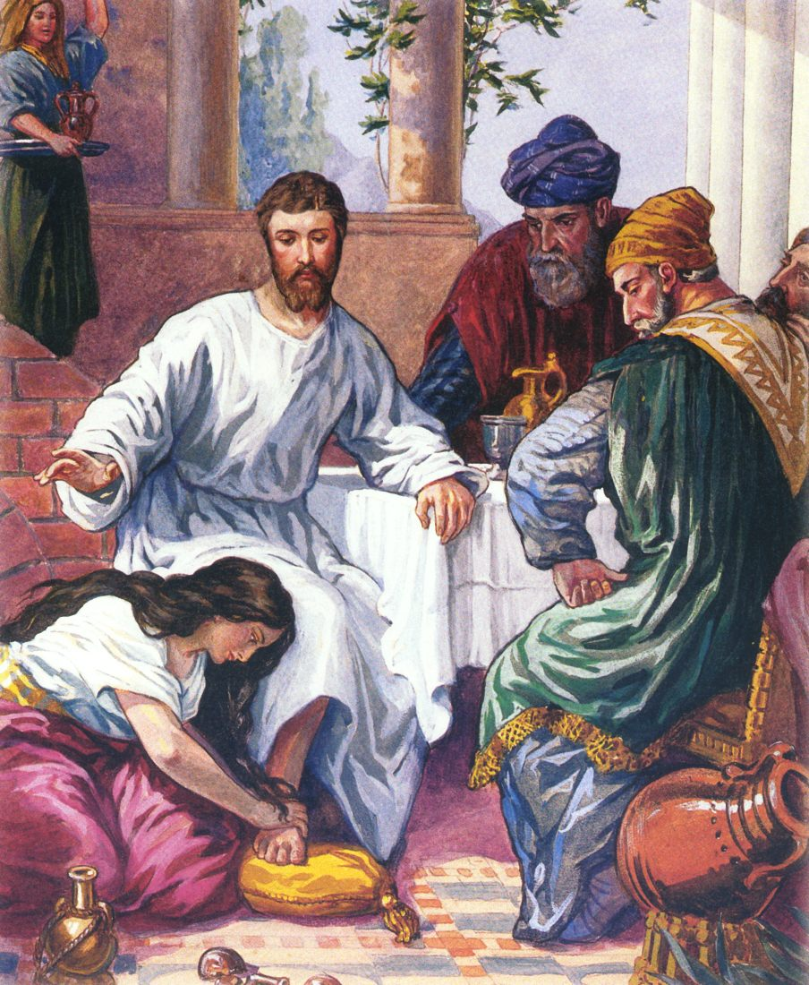
Lk. 7:37-50

Slide 15
We must also consider that the only baptism the thief could have had was John’s baptism because the baptism that Jesus commanded did not happen until after the cross when He gave The Great Commission (Mat. 28:19; Mk. 16:16).

Slide 16
“For where there is a testament, there must also of necessity be the death of the testator. For a testament is in force after men are dead, since it has no power at all while the testator lives (Heb. 9:16-17).”

Slide 17
Mark 16:16 "He who believes and is baptized will be saved; but he who does not believe will be condemned.

Slide 18
John 19:26 When Jesus therefore saw His mother, and the disciple whom He loved standing by, He said to His mother, "Woman, behold your son!" ²⁷ Then He said to the disciple, "Behold your mother!" And from that hour that disciple took her to his own home.

Slide 19
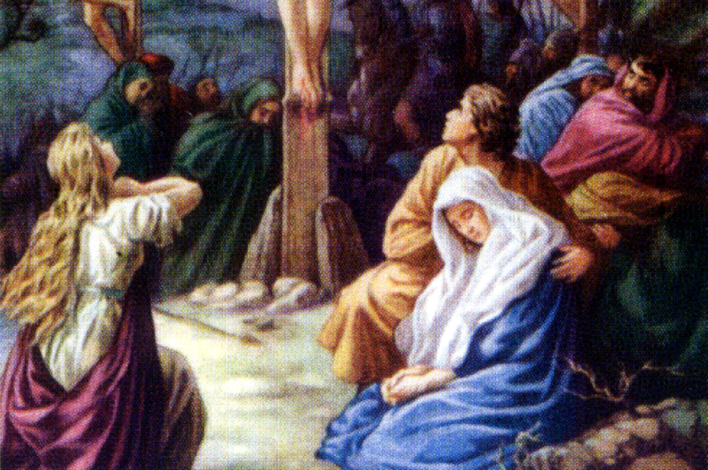

Slide 20
Luke 2:34 Then Simeon blessed them, and said to Mary His mother, "Behold, this Child is destined for the fall and rising of many in Israel, and for a sign which will be spoken against 35 "(yes, a sword will pierce through your own soul also), that the thoughts of many hearts may be revealed."

Slide 21
Jn. 19:25 | Sister of Jesus’ mother | Mary the wife of Clopas | Mary Magdalene
Mk. 15:40 | Salome | Mary the mother of James the Less and Joses | Mary Magdalene
Mt. 27:56 | Mother of Zebedee’s sons | Mary the mother of James and Joses | Mary Magdalene
Mk. 16:1 | Salome | Mary the mother of James | Mary Magdalene
Mary Magdalen and Jesus’ mother Mary are the easy ones to identify.

Slide 22
Jn. 19:25 | Sister of Jesus’ mother | Mary the wife of Clopas | Mary Magdalene
Mk. 15:40 | Salome | Mary the mother of James the Less and Joses | Mary Magdalene
Mt. 27:56 | Mother of Zebedee’s sons | Mary the mother of James and Joses | Mary Magdalene
Mk. 16:1 | Salome | Mary the mother of James | Mary Magdalene
In the middle of our chart John talks about Mary the wife of Clopas. “According to tradition, Clopas was the same person as Alphaeus, the father of James the Less and of Joses (Matt. 10:3; Mark 15:40)” (Nelson’s New Illustrated Bible Dictionary, p. 284).

Slide 23
Jn. 19:25 | Sister of Jesus’ mother | Mary the wife of Clopas | Mary Magdalene
Mk. 15:40 | Salome | Mary the mother of James the Less and Joses | Mary Magdalene
Mt. 27:56 | Mother of Zebedee’s sons | Mary the mother of James and Joses | Mary Magdalene
Mk. 16:1 | Salome | Mary the mother of James | Mary Magdalene
When we compare Mk. 15:40 to Mt. 27:56, we can make a strong case that Salome is the mother of Zebedee’s sons James and John. If John is staying consistent with these other accounts, then Salome is the sister of Jesus’ mother, which means James and John are Jesus’ first cousins.

Slide 24
Matthew 27:45 Now from the sixth hour until the ninth hour there was darkness over all the land. ⁴⁶ And about the ninth hour Jesus cried out with a loud voice, saying, "Eli, Eli, lama sabachthani?" that is, "My God, My God, why have You forsaken Me?"

Slide 25
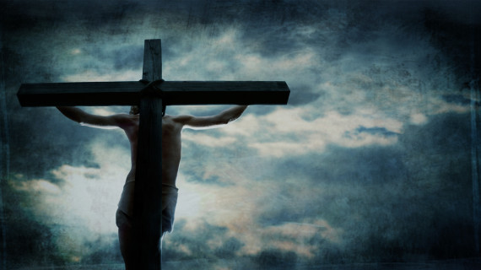
Amos 8:9 "And it shall come to pass in that day," says the Lord GOD, "That I will make the sun go down at noon, And I will darken the earth in broad daylight;

Slide 26
Tertullian said:
In the same hour too, the light of day was withdrawn, when the sun at the very time was in his meridian blaze. Those who were not aware that this had been predicted about Christ, no doubt thought it an eclipse. You yourselves have the account of the world portent still in your archives! (Tertullian, Apology in the Ante-Nicene Fathers (Grand Rapids, Michigan: William B. Eerdmans Publishing Company, 1957), Vol. III, p. 35.)

Slide 27
Pontius Pilate sent the following report to Tiberius, emperor of Rome:
And when he had been crucified, there was darkness over the whole earth, the sun having been completely hidden, and the heaven appearing dark, so that the stars appeared, but had at the same time their brightness darkened, as I suppose your reverence is not ignorant of, because in all the world they lighted lamps from the sixth hour until evening. And the moon, being like blood, did not shine the whole night, and yet she happened to be at the full. (Pontius Pilate, To Tiberius in Ibid., Vol. III, p. 463.)

Slide 28
Hebrews 10:19 Therefore, brethren, having boldness to enter the Holiest by the blood of Jesus, 20 by a new and living way which He consecrated for us, through the veil, that is, His flesh,

Slide 29
⁴⁶ And about the ninth hour Jesus cried out with a loud voice, saying, "Eli, Eli, lama sabachthani?" that is, "My God, My God, why have You forsaken Me?"

Slide 30
Generally, brethren (including many able scholars in the Word) have explained that, because Jesus was "made to be sin" (2 Cor. 5:21; cf. John 1:29; Gal. 3:13; Isa. 53:10), God could no longer look upon Him and thus turned away from Him. They teach that it was not because of any sin the Christ had committed (Heb. 4:15; 7:26; 9:14; et al.) that God in some sense forsook His Son in this awful hour.

Slide 31
Rather, He did so because the Lord bore the sins of all humanity for all time (Isa. 53:4-5,8,11-12). The sins of others which He bore did not make Him a sinner, but He was nonetheless laden with those sins on the cross. These brethren further reason that God either did forsake the Lord or He did not, and Jesus said He did. Moreover, God did not respond to Jesus' pleading question with a denial that He had forsaken Him. (Denton Lectures on Matthew)

Slide 32
Hebrews 9:13 For if the blood of bulls and goats and the ashes of a heifer, sprinkling the unclean, sanctifies for the purifying of the flesh, ¹⁴ how much more shall the blood of Christ, who through the eternal Spirit offered Himself without spot to God, cleanse your conscience from dead works to serve the living God?

Slide 33
1 Peter 1:18 knowing that you were not redeemed with corruptible things, like silver or gold, from your aimless conduct received by tradition from your fathers, ¹⁹ but with the precious blood of Christ, as of a lamb without blemish and without spot.
Paul tells us this:
Ephesians 5:2 And walk in love, as Christ also has loved us and given Himself for us, an offering and a sacrifice to God for a sweet-smelling aroma.

Slide 34
Luke 24:44 Then He said to them, "These are the words which I spoke to you while I was still with you, that all things must be fulfilled which were written in the Law of Moses and the Prophets and the Psalms concerning Me."

Slide 35
Psalm 22:1 My God, My God, why have You forsaken Me? Why are You so far from helping Me, And from the words of My groaning?
Psalm 22:7 All those who see Me ridicule Me; They shoot out the lip, they shake the head, saying, ⁸ "He trusted in the LORD, let Him rescue Him; Let Him deliver Him, since He delights in Him!"

Slide 36
Psalm 22:15 My strength is dried up like a potsherd, And My tongue clings to My jaws; You have brought Me to the dust of death. ¹⁶ For dogs have surrounded Me; The congregation of the wicked has enclosed Me. They pierced My hands and My feet; ¹⁷ I can count all My bones. They look and stare at Me. ¹⁸ They divide My garments among them, And for My clothing they cast lots.

Slide 37
In what way was Jesus forsaken? The first view would say that the Father separated Himself from Jesus. The second view would say that He simply forsook Him in that He did not rescue Him from physical death though He would be raised from the dead in 3 days.

